Slide 1

Malignant comment classifier
prototype which helps to evaluate the hate and abusive comments

Slide 2
Contents
Problem Statement
EDA Steps & Visualization
Methodology
Modelling
Conclusion

Slide 3
Problem Statement
The proliferation of social media enables people to express their opinions widely online. However, at the same time, this has resulted in the emergence of conflict and hate, making online environments uninviting for users. Although researchers have found that hate is a problem across multiple platforms, there is a lack of models for online hate detection.
Online hate, described as abusive language, aggression, cyberbullying, hatefulness and many others has been identified as a major threat on online social media platforms. Social media platforms are the most prominent grounds for such toxic behavior.
There has been a remarkable increase in the cases of cyberbullying and trolls on various social media platforms. Many celebrities and influences are facing backlashes from people and have to come across hateful and offensive comments. This can take a toll on anyone and affect them mentally leading to depression, mental illness, self-hatred and suicidal thoughts.
Internet comments are bastions of hatred and vitriol. While online anonymity has provided a new outlet for aggression and hate speech, machine learning can be used to fight it. The problem we sought to solve was the tagging of internet comments that are aggressive towards other users.
Our goal is to build a prototype of online hate and abuse comment classifier which can used to classify hate and offensive comments so that it can be controlled and restricted from spreading hatred and cyberbullying.

Slide 4
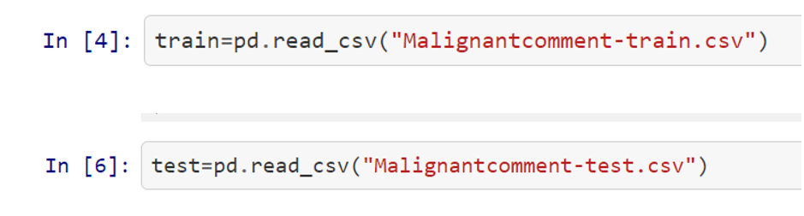
Exploratory data analysis
Import csv: Loading the data

Slide 5
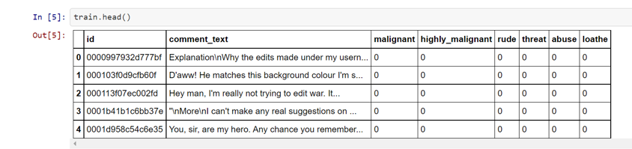
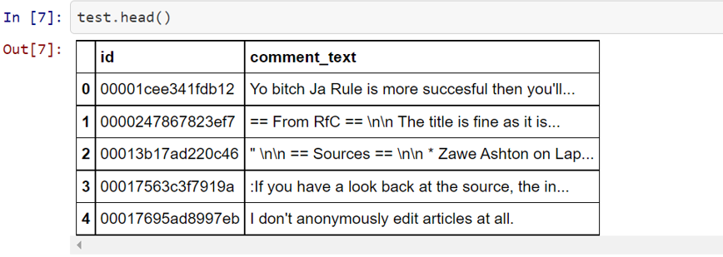
Exploratory data analysis
data

Slide 6
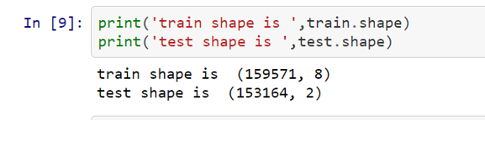
Exploratory data analysis
SHAPE OF data

Slide 7
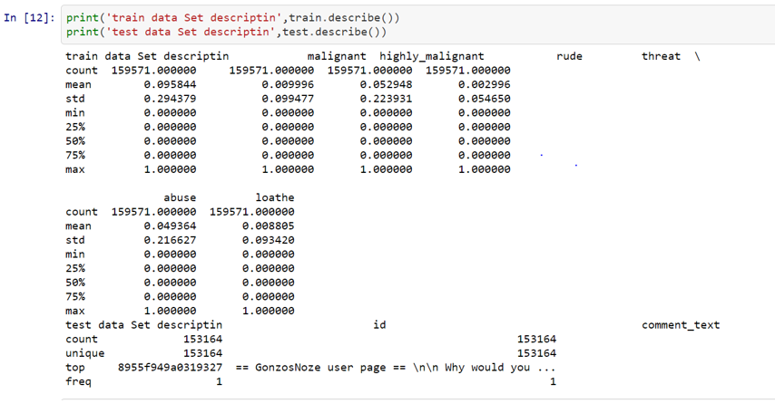
Exploratory data analysis
DESCRIPTIVE STATISTICS

Slide 8
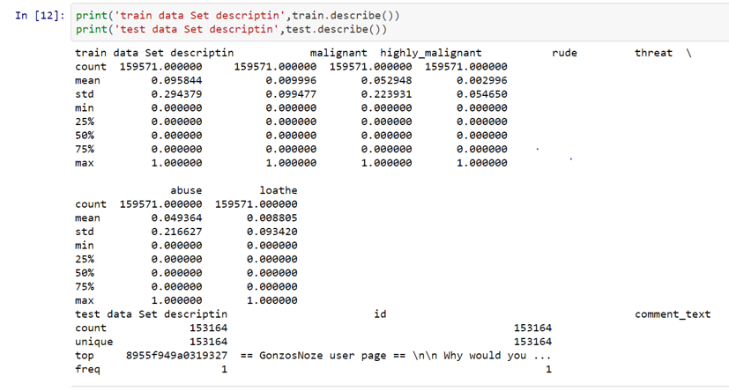
Exploratory data analysis

Slide 9
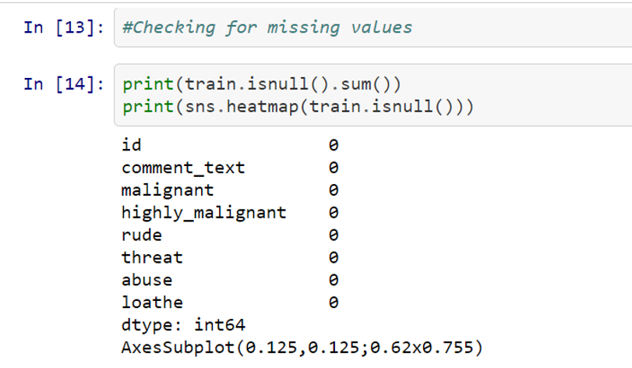
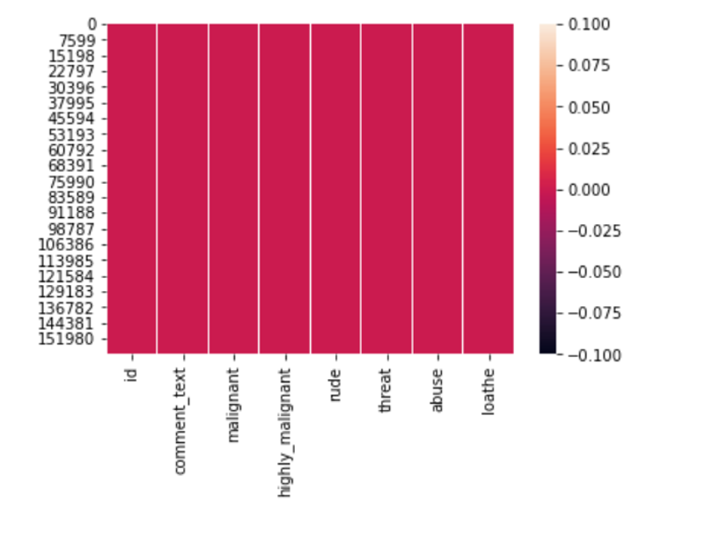
DATA PREPROCESSING
i) CHECKING MISSING VALUES

Slide 10
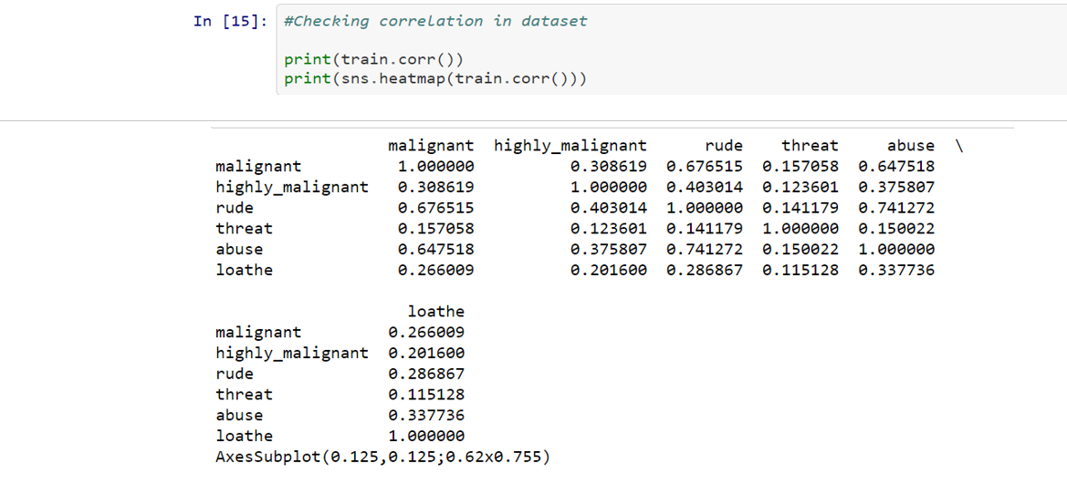
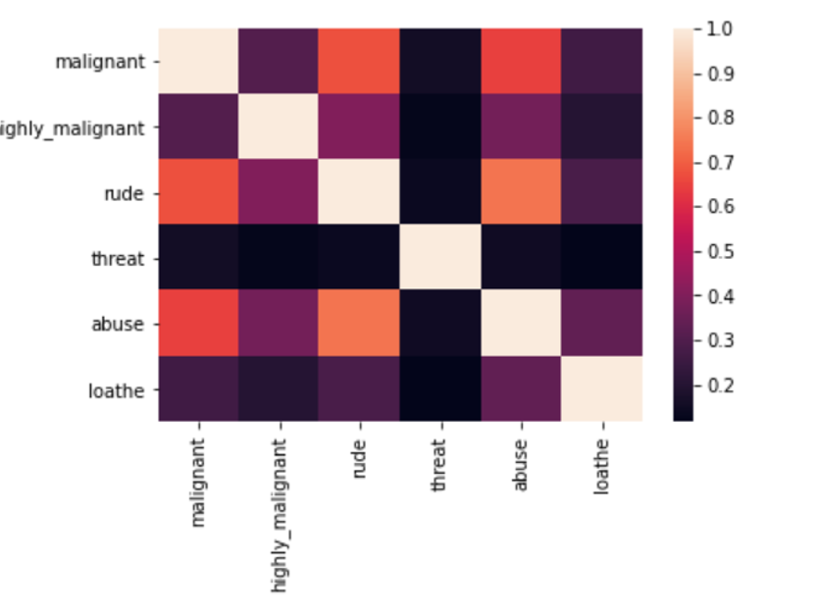
DATA PREPROCESSING
II)CORRELATION

Slide 11
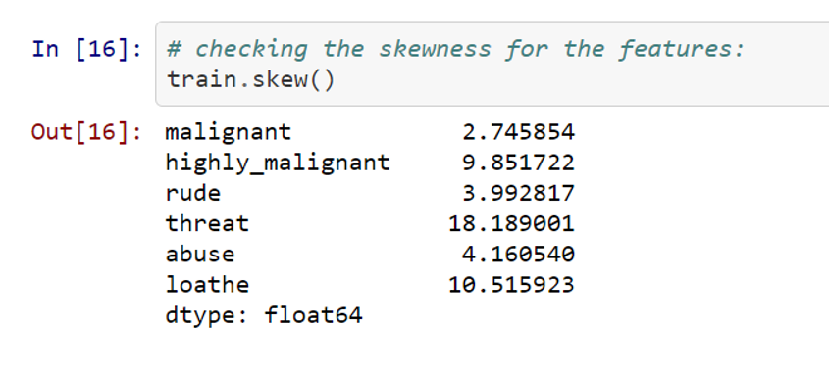
Data PrepROCESSING
Iii)checking the skewness of the features

Slide 12
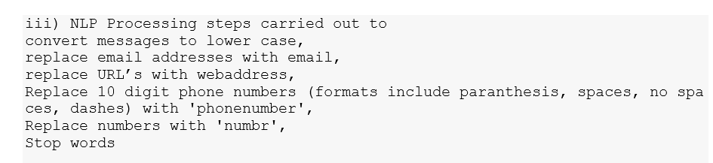
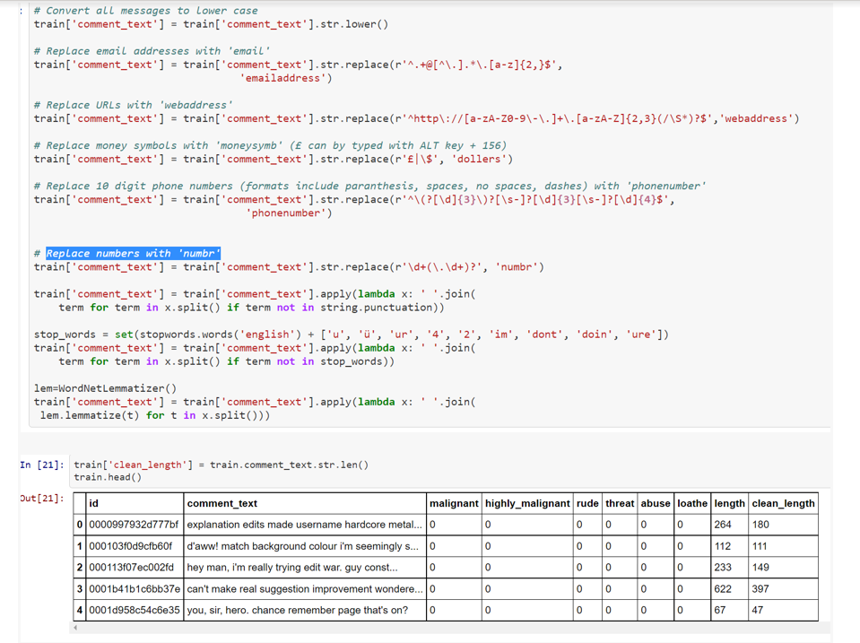
IV) NLP PROCESSING

Slide 13
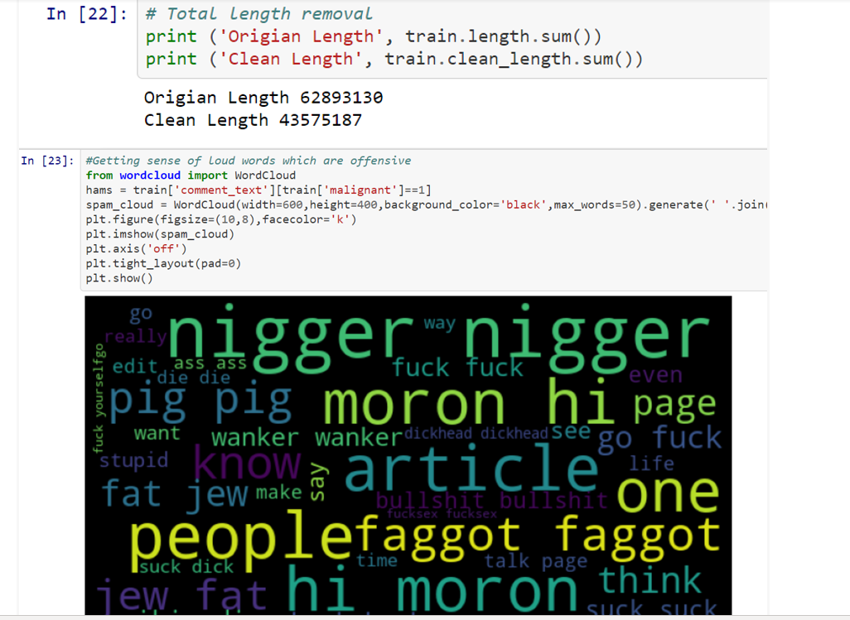
NLP PROCESSING

Slide 14
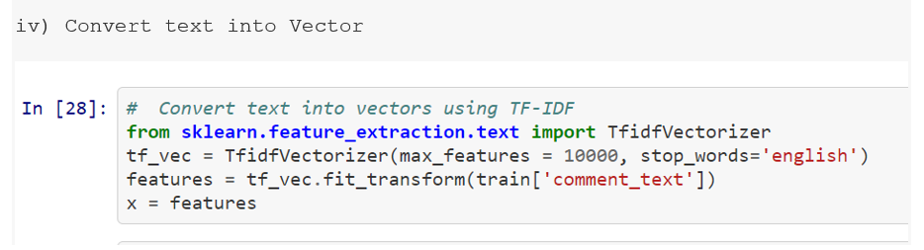
V) CONVERTING TEXT INTO VECTOR

Slide 15
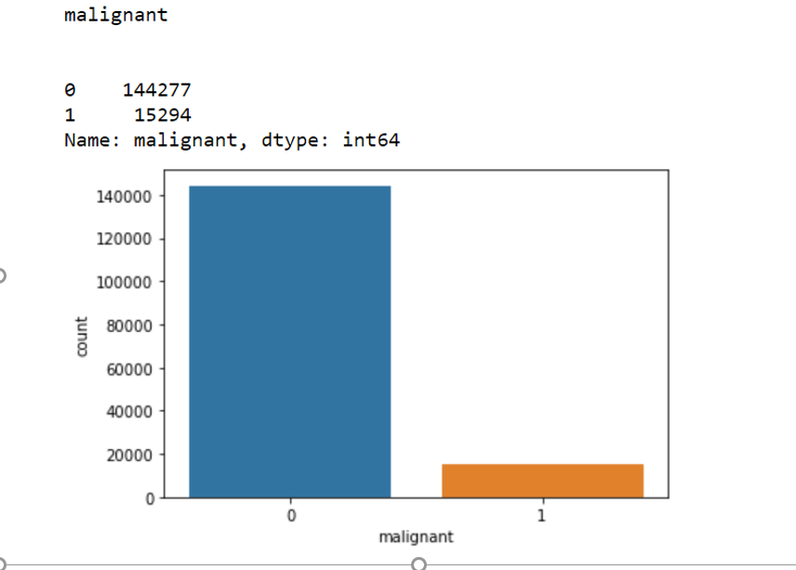
Visualization
Various Independent variables & relationship with target variable

Slide 16
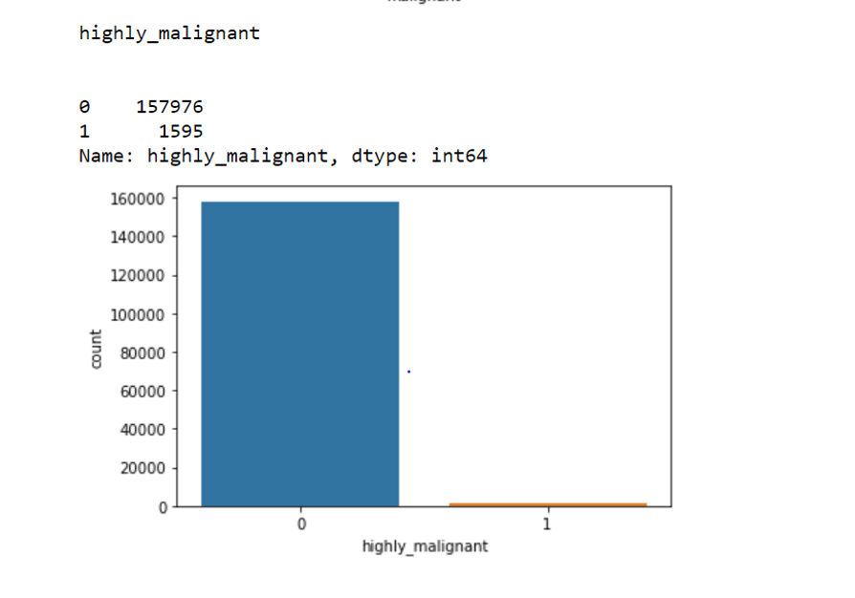
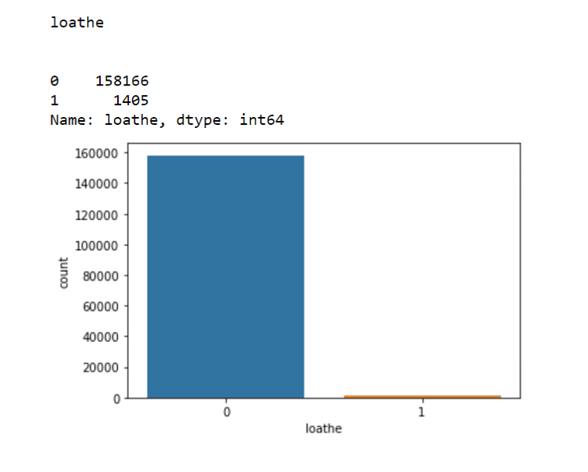
Visualization

Slide 17
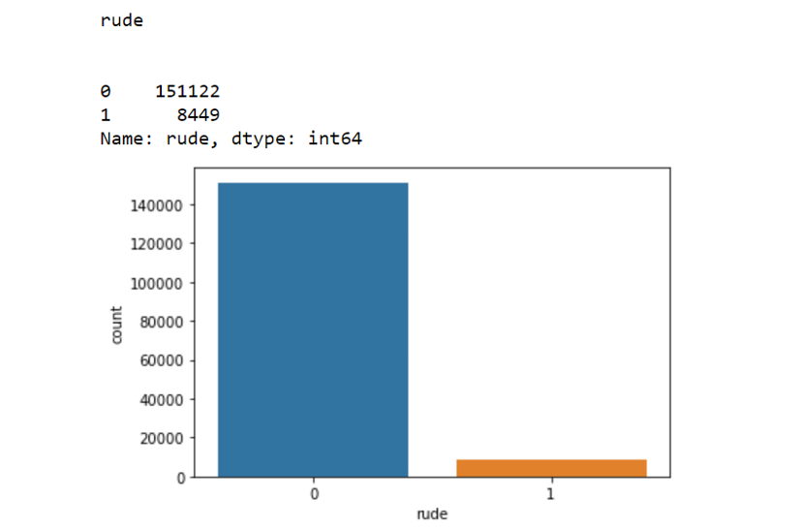
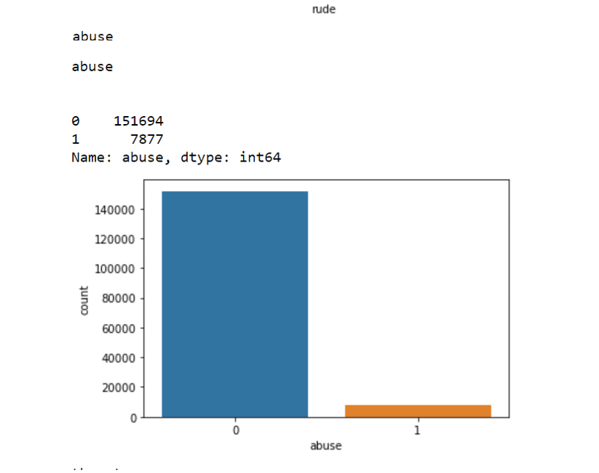
Visualization

Slide 18
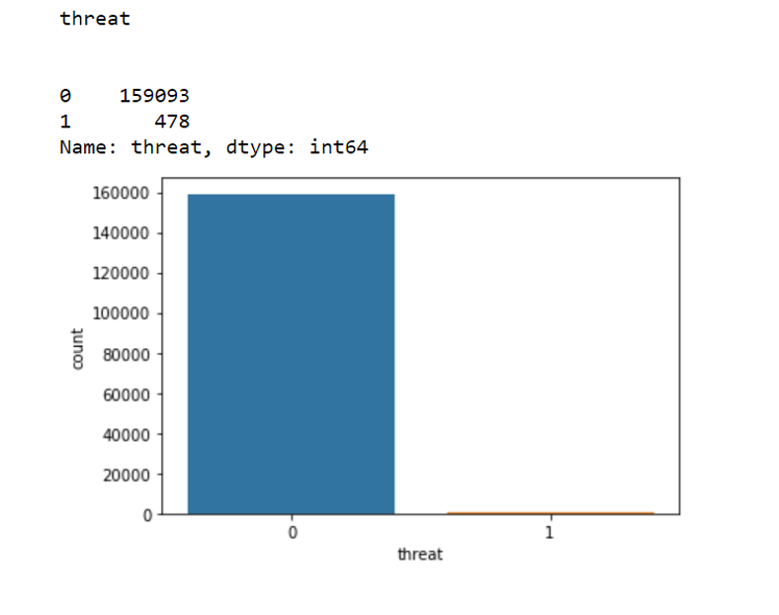
Visualization

Slide 19
METHODOLOGY
Data Exploration and Cleaning On data exploration, I found that there were missing values, skewness, unwanted columns which were treated before Modelling
Feature Selection was done by various methods by plotting correlation matrix, HEATMAP, Elf.
Data Visualization: On visualizing data, We could see the different features in detail
Once the data preparation was done by taking the above required steps then splitting the data was carried out for modelling.

Slide 20
Model Building
Different types of Model As specified below have been run :
LOGISTIC REGRESSION
DECISION TREE CLASSIFIER
RANDOM FOREST CLASSIFIER
XGBOOST CLASSIFIER
ADABOOST
K-Neighbors CLASSIFIER

Slide 21
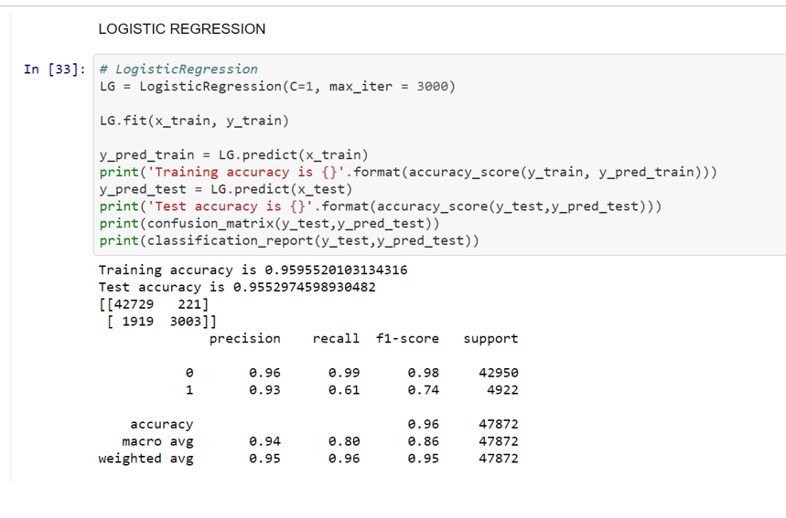
Modelling
CHECKING PERFORMANCE OF BASE MODELS BY Finding the accuracy and confusion matrix

Slide 22
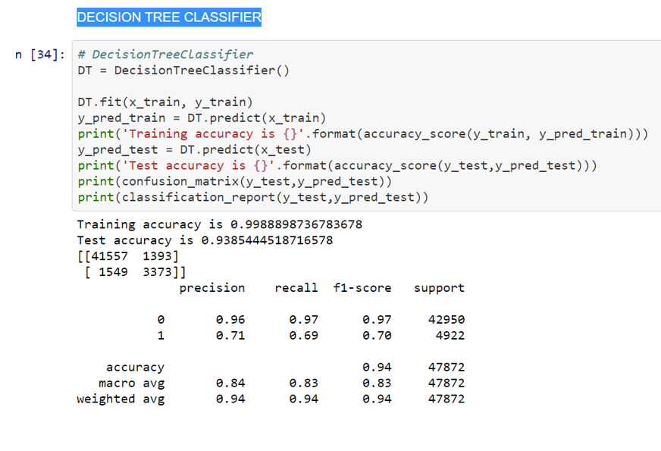
Modelling
DECISION TREE CLASSIFIER

Slide 23
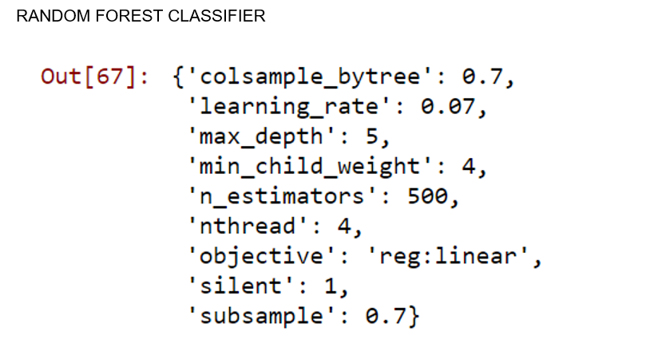
RANDOM FOREST CLASSIFIER

Slide 24
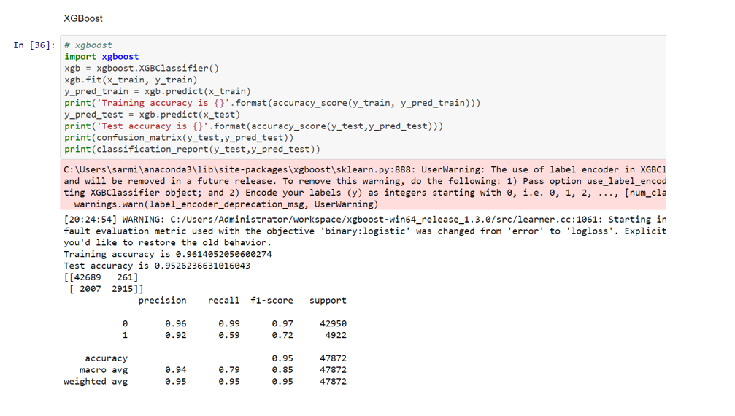
XGBOOST CLASSIFIER

Slide 25
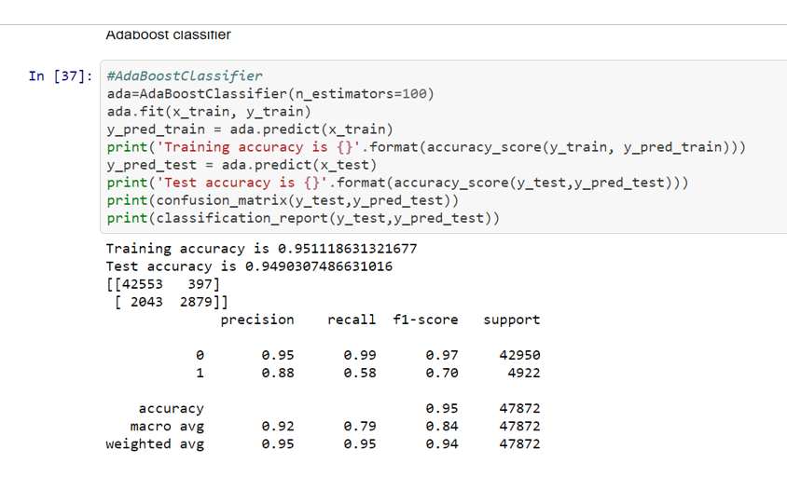
ADABOOST CLASSIFIER

Slide 26
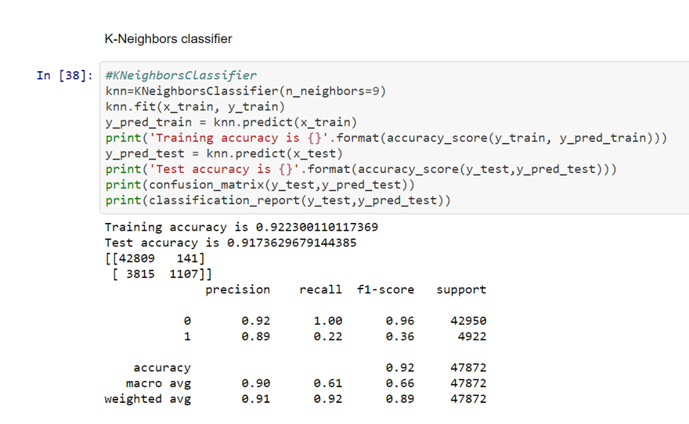
K-NEIGHBORS CLASSIFIER

Slide 27
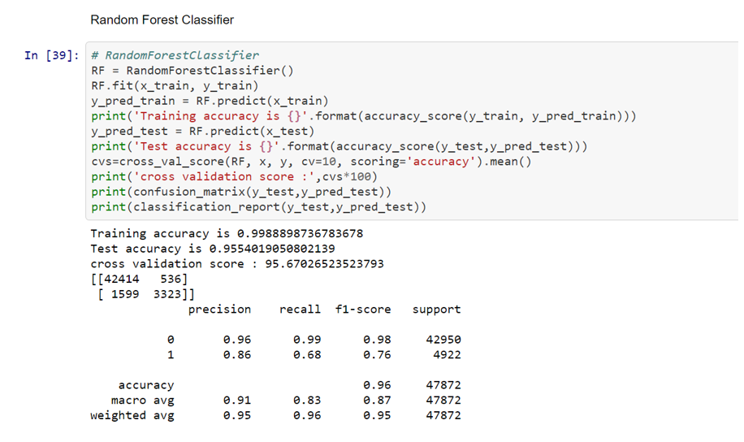
TUNING THE BEST PERFORMING MODEL

Slide 28
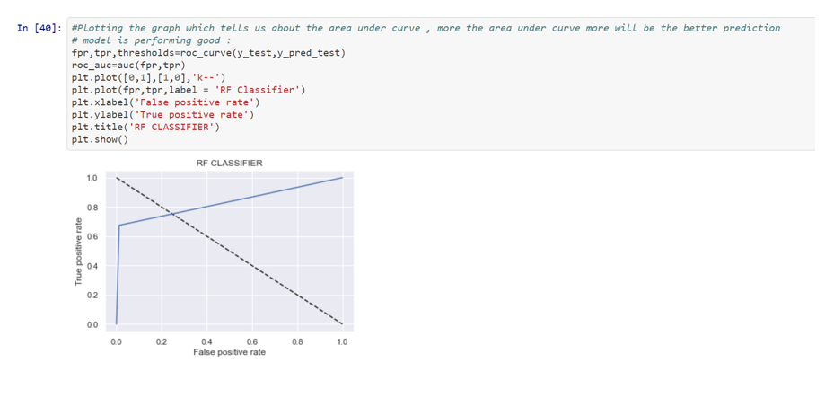
ROC-AUC CURVE

Slide 29
CONCLUSION
According to the performance metrics, RANDOM FOREST CLASSIFIER is the best performing model

